Slide 1
Click here to go to the next slide!
Welcome to the name you school band room! I’m so glad you are here!

Slide 2
Click here to go to the next slide!
In grade 6 band, students choose from flute, clarinet, trumpet, trombone, euphonium, and tuba.
We add percussion, saxophone and other instruments to our band later on.

Slide 3
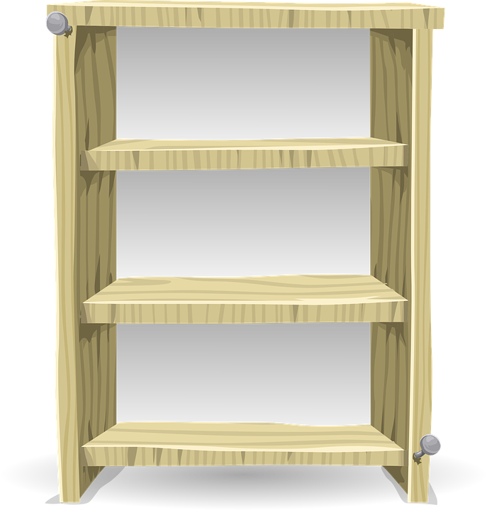
Click here to go to the next slide!
Let’s explore the instruments and find out what instrument you might like to choose for band!
Click each instrument on the next slide to learn more!

Slide 4
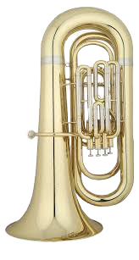
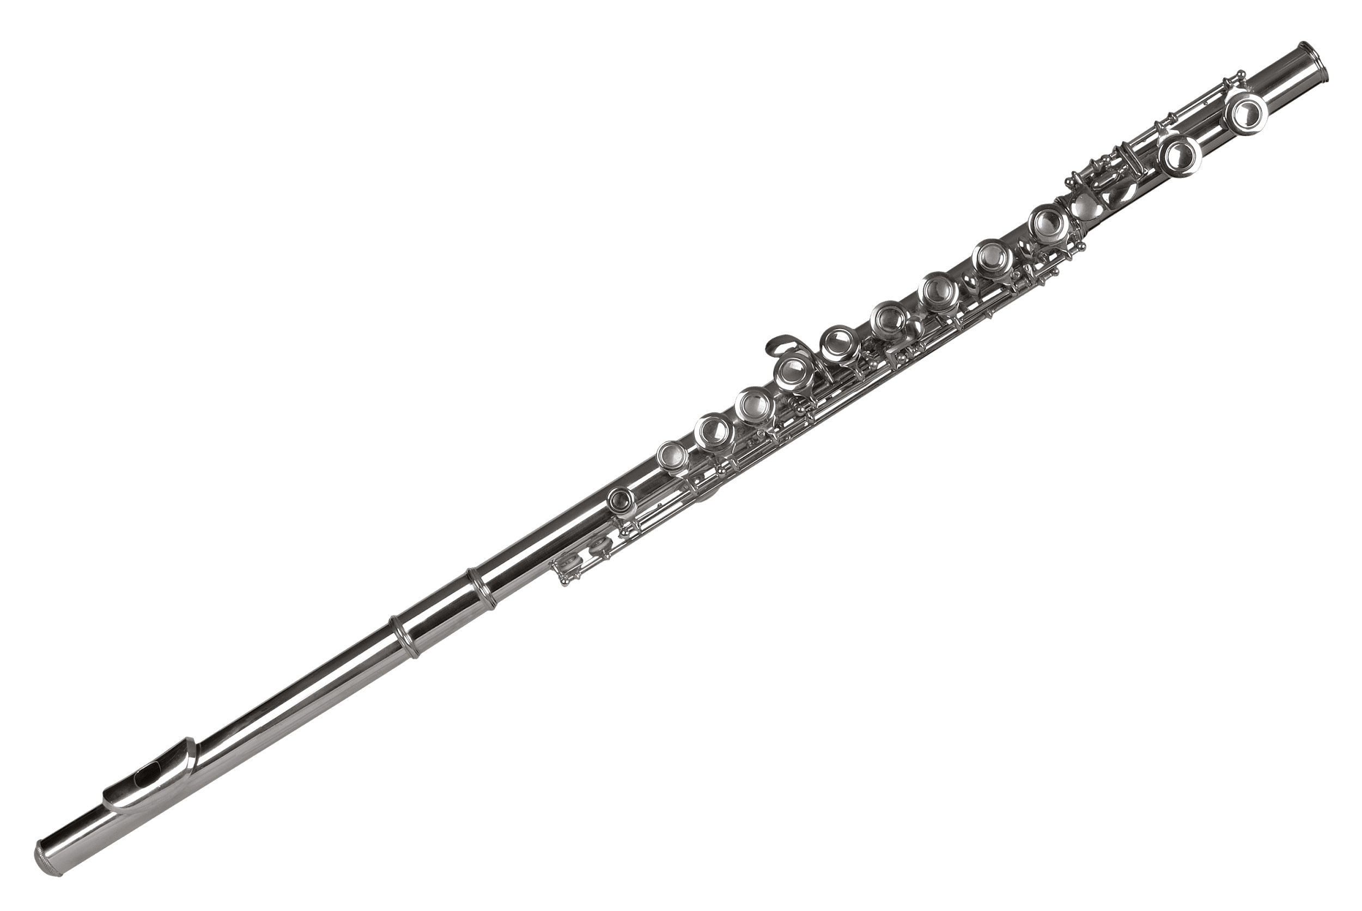
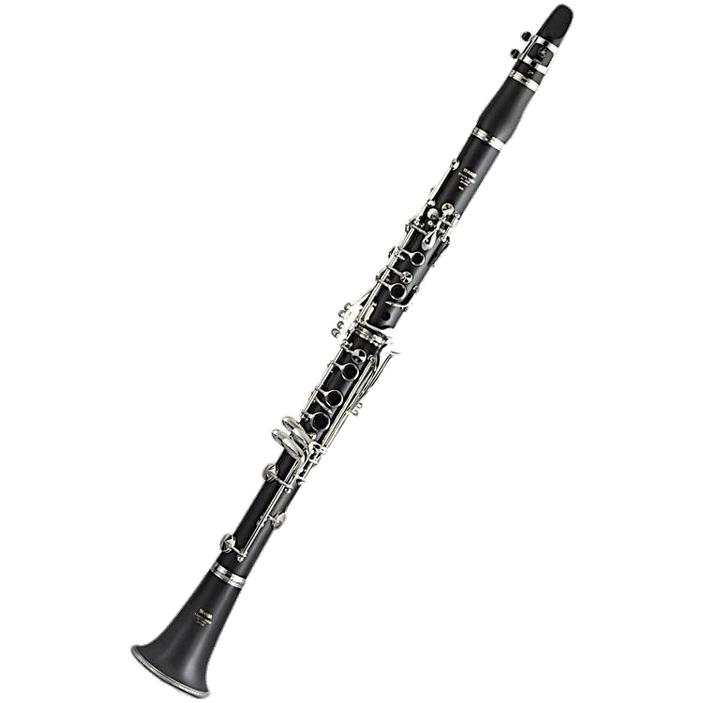
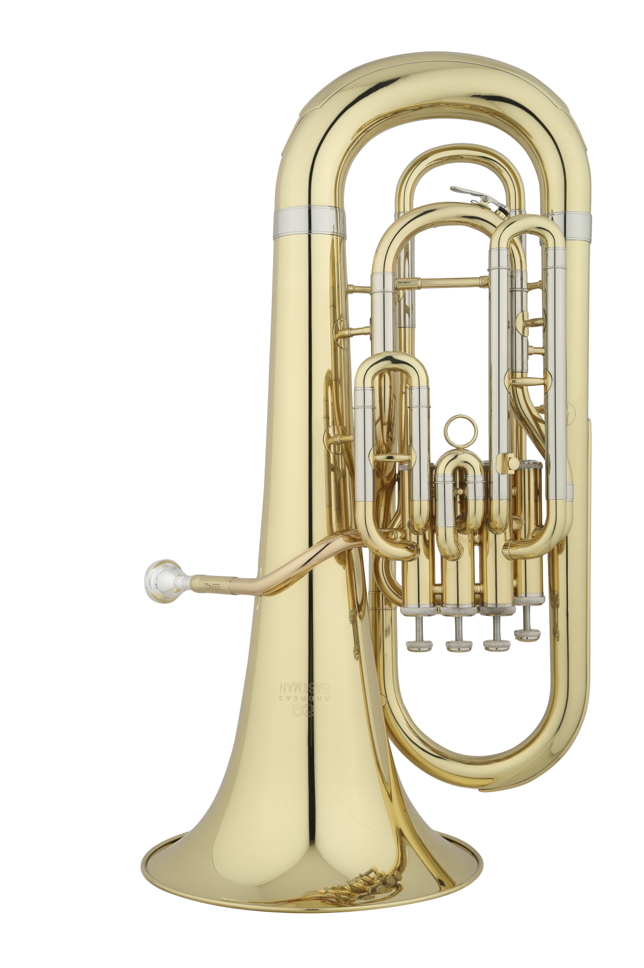
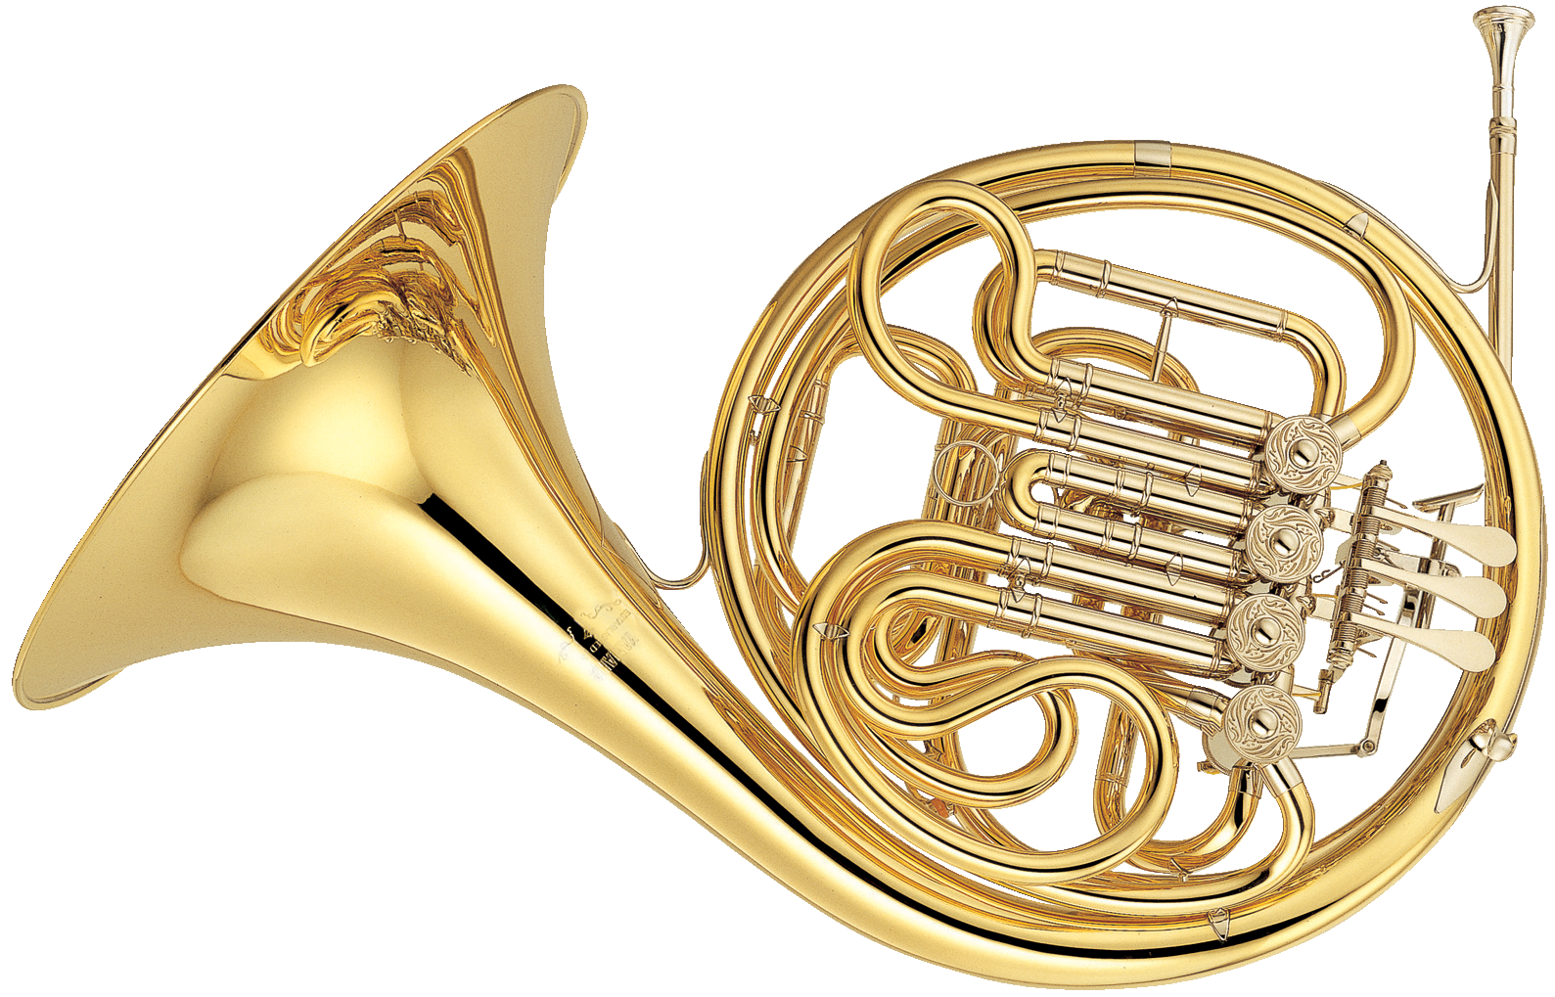
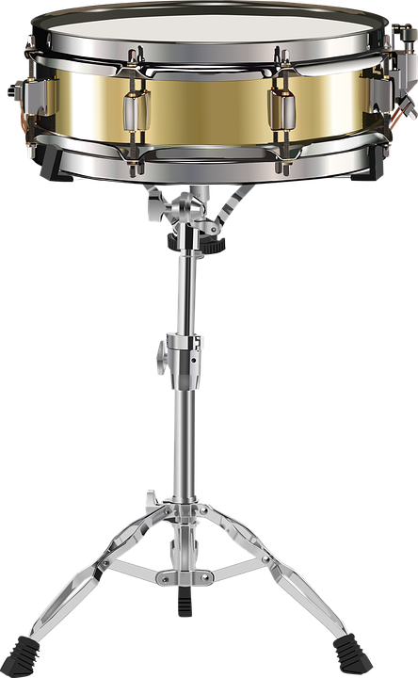
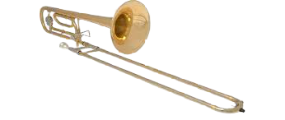

Slide 5
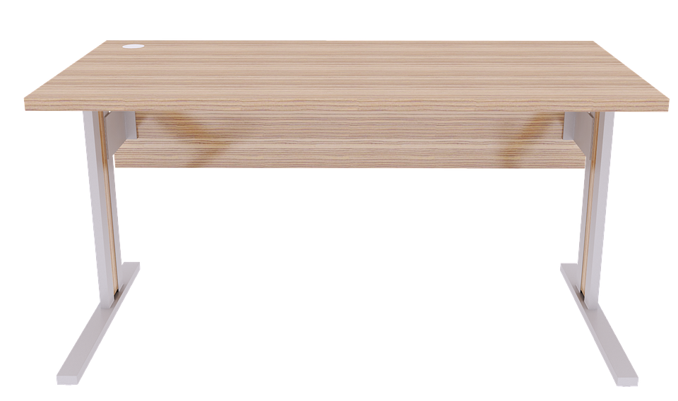
Click to go back to the instrument shelves.
The flute! Click it to learn more.

Slide 6
Flute
Click to go back to the instrument shelves.
Woodwind instrument, but made of metal.
No reed.
Smallest and lightest band instrument (except for piccolo).
Often plays the melody.
Plays high notes.
Press keys and adjust your air to get different notes.
Click here and here and here to listen the flute.

Slide 7
Click to go back to the instrument shelves.
The clarinet! Click it to learn more.

Slide 8
Clarinet
Click to go back to the instrument shelves.
Woodwind instrument.
Uses a single reed.
Quite light and portable.
Usually plays melodies or harmony lines.
Can play very low and very high.
B-flat clarinet is most common, but our school also has bass clarinets (Bass clarinet becomes an option in grade 8, but you have to play clarinet in grade 7).
Press keys to get different notes.
Click here and here and here to here the clarinet.
Click here to hear a bass clarinet.

Slide 9
Click to go back to the instrument shelves.
The trumpet! Click it to learn more.

Slide 10
Trumpet
Click to go back to the instrument shelves.
Brass instrument.
Makes a sound by buzzing your lips on a mouthpiece.
Fairly light with a smaller case.
Usually plays melodies or harmony lines.
Change your air and press valves to change the notes.
Plays medium to high notes.
Click here and here and here to hear a trumpet.

Slide 11
Click to go back to the instrument shelves.
The trombone! Click it to learn more.

Slide 12
Trombone
Click to go back to the instrument shelves.
Brass instrument.
Makes a sound by buzzing your lips on a large mouthpiece.
Larger case but not too heavy.
Usually plays harmony parts or bass lines.
Adjust your air and the slide to change the notes.
Plays medium to low notes.
Click here and here and here to hear a trombone.

Slide 13
Click to go back to the instrument shelves.
The euphonium! Click it to learn more.

Slide 14
Euphonium
Click to go back to the instrument shelves.
Brass instrument.
Looks like a miniature tuba.
Makes a sound by buzzing your lips on a large mouthpiece.
Larger and heavier than some other instruments.
Usually plays harmony and bass lines.
Plays medium to low notes.
Adjust your air and press the valves to change the notes.
Sounds similar to a trombone.
Click here and here and here to hear a euphonium.

Slide 15
Click to go back to the instrument shelves.
The tuba! Click it to learn more.

Slide 16
Tuba
Click to go back to the instrument shelves.
Brass instrument.
Makes a sound by buzzing your lips on a large mouthpiece.
Largest instrument in the band.
Usually plays bass lines.
Plays the lowest notes in the band.
Adjust your air and press the valves to change the notes.
Usually only one or two in a band.
Click here and here and here to hear a tuba.

Slide 17
Click to go back to the instrument shelves.
Percussion is everything in the band that we hit, shake, or scrape to make a sound.
Percussionists play lots of different instruments. Click the drum to learn more.

Slide 18
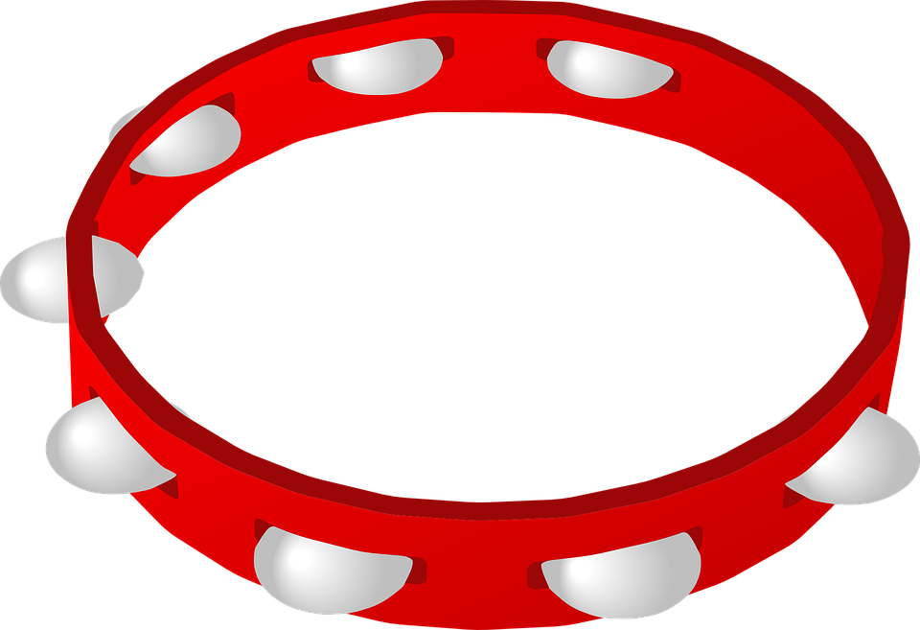
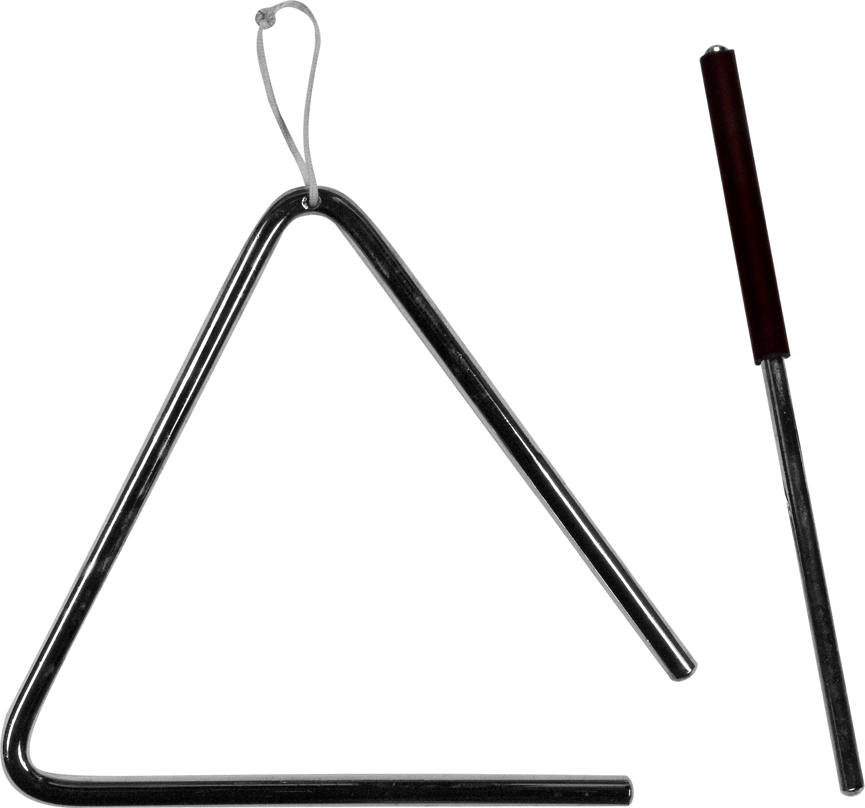
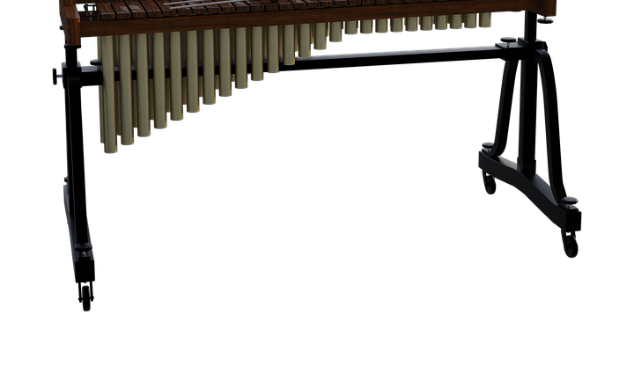
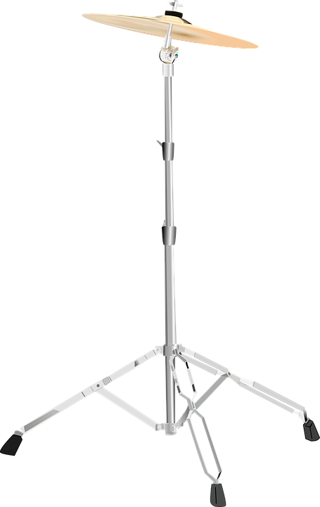
Percussion
Click to go back to the instrument shelves.
Percussionists are responsible for lots of different instruments.
Xylophone
Glockenspiel
Timpani
Snare Drum
Bass Drum
Chimes
Triangle
Tambourine
Cymbals
Lots more!
Click here and here and here to hear some percussion.

Slide 19
Click to go back to the instrument shelves.
The French horn! Click it to learn more.

Slide 20
French Horn
Click to go back to the instrument shelves.
Brass instrument.
Makes a sound by buzzing your lips on a small mouthpiece.
Larger case but not too heavy.
Usually plays harmony lines.
Can play quite low and quite high.
Good for players with strong musical ears.
Click here and here and here to hear a French horn.

Slide 21
Click to go back to the instrument shelves.
The saxophone! Click it to learn more.

Slide 22
Saxophone
Click to go back to the instrument shelves.
Woodwind instrument, but made of metal.
Uses a single reed.
Plays melodies and harmony lines.
Our school has three kinds: Alto, Tenor, and Baritone. Click the links to hear each kind.
Alto plays higher notes, tenor plays medium notes, and baritone plays low notes.
Press keys to change the notes.
Saxophones become an option in Grade 8 (by audition), but you have to play flute or clarinet in grade 7 to be eligible.

Slide 23
Click to go back to the instrument shelves.
The oboe! Click it to learn more.

Slide 24
Oboe
Click to go back to the instrument shelves.
Woodwind instrument.
Uses a double reed.
Quite light and portable.
Usually plays melodies or harmony lines.
Plays higher notes, similar to the flute.
Press keys to change the notes.
Is a unique sounding instrument and bands usually only have one or two oboe players.
Is good for someone with strong musical ears.
Click here and here to hear an oboe.

Slide 25
THANK-YOU FOR COMING!
HOPE TO SEE YOU IN BAND NEXT YEAR.

